Slide 1
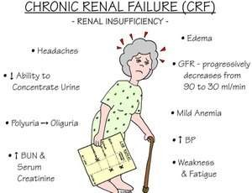
Acute and chronic renal failure
Dr. Jackson Kwizera Ndekezi
Anesthesiologist
Critical care fellow
University of Rwanda

Slide 2
Renal failure
Renal failure is defined as a significant loss of renal function in both kidneys to the point where less than 10 to 20% of normal GFR remains.
Renal failure may occur as an acute and rapidly progressing process.
Acute renal failure has an abrupt onset and is potentially reversible.
Chronic failure progresses slowly over at least three months
and can lead to permanent renal failure.

Slide 3
Pathophysiology of Renal Failure
In renal failure there is either glomerular or dysfunction
e.g.
glomerulonephritis primarily causes of glomerular damage
aminoglycoside nephrotoxicity is mainly in tubular
tubular
Glomerular dysfunction- As the main function of glomeruli is filtration, glomerular dysfunction leads to fall in GFR.
Tubular Dysfunction- As the main function of tubules is reabsorption tubular failure results in the voiding of large volumes of dilute urine (polyuria) of low specific gravity, along with electrolytes and nutrients.

Slide 4
Acute renal failure
Sudden decrease in renal function.
Acute renal failure may be pre-renal, intra-renal or post-renal in nature.
Acute renal failure is often reversible so long as permanent injury to the kidney has not occurred.
Manifestations
Oliguria (reduced urine output)
Possible edema and fluid retention
Elevated blood urea nitrogen levels (BUN) and serum creatinine
Alterations in serum electrolytes

Slide 5
Causes of Acute Renal Failure
Myocardial infarction, rhabdomyolysis, flow, obstruction,
decreased
blood
hemolytic uremic syndrome, common causes of acute renal
Glomerulonephritis are failure.
Acute Renal Failure classified as pre-renal failure, intra-renal failure and post-renal failure
Pre-renal failure
Results from impaired or reduced blood flow to the kidney
Possible causes: shock, hypotension, anaphylaxis, ischemic formation

Slide 6
Causes of Acute Renal Failure
Intra-renal failure
Results from acute damage to renal structures
Possible causes:
acute glomerulonephritis, pyelonephritis
May also result from acute tubular necrosis (ATN)
damage of kidney structure from exposure to toxins, solvents, drugs and heavy metals; ATN is the most common cause of acute renal failure
Post-renal failure
Results from conditions block of urine outflow
Possible causes: obstruction of urine outflow by calculi, tumors, prostatic hypertrophy

Slide 7
Symptoms of acute renal Failure
Decreased kidney function (electrolyte imbalance)
Obstruction in the urinary tract
Blood in urine
Reduced urine output
Dehydration
Detectable abnormal mass
Pale skin
Poor appetite
Diagnosis
Routine laboratory test (creatinine and blood urea nitrogen)
Ultrasound of the kidney helps to determine whether
kidney
problem is acute or chronic.
kidney biopsy
computed tomography scan

Slide 8
Treatment of acute renal failure
Treatment
Prevention of acute renal failure through support of blood pressure and blood volume
Correction of fluid and electrolyte imbalances
Dialysis, which may be employed while the kidneys are in the recovery phase
Low protein, high carbohydrate diet to minimize the formation of nitrogenous wastes

Slide 9
Chronic renal failure
Chronic renal failure is the end result of progressive kidney damage and loss of function. Chronic renal failure is often classified into four progressive stages based on the loss of GFR.
Stages of Chronic Renal Failure
Diminished renal reserve — GFR decreased to 35 to 50% of normal Renal insufficiency — GFR decreased to 20 to 35% of normal
Renal failure — GFR reduced to less than 20% of normal
End-Stage Renal Disease — GFR is less than 5% of normal

Slide 10
Causes of chronic renal failure
Chronic glomerulonephritis
Chronic infections
Renal obstruction (prolonged)
Exposure to toxic chemicals, toxins or
(aminoglycoside antibiotics and nephrotoxicity)
Diabetes
Hypertension
Nephrosclerosis (atherosclerosis of the renal artery)
Diabetic nephropathy
drugs
Alport syndrome (inherited disorder causes progressive kidney damage and eye defects)
Polycystic kidney disease
Interstitial nephritis or pyelonephritis
deafness,

Slide 11
Symptoms of chronic renal failure
Until very kidney function remains, chronic renal failure may not developed
Anemia, increased levels of phosphates (in blood) are
complications of kidney failure
Malaise
Dry skin
Poor appetite
Vomiting
Bone pain
metallic taste in mouth
detectable abdominal mass

Slide 12
Manifestations of chronic renal failure
– Renal failure is a multisystem disease
System | Effect | Cause
Body fluids | Polyuria | Metabolic acidosis
 | Metabolic acidosis | Reduced H⁺ excretion
 | Abnormal levels of Na⁺, K⁺, Ca²⁺, PO4⁻ | Loss of tubular function
Hematologic | Anemia, excess bleeding | Impaired erythropoietin
Cardiovascular | Hypertension, edema | Activation of renin–angiotensin system
Gastrointestinal tract | Anorexia, nausea | Accumulation of metabolic wastes
Neurologic | Uremic encephalopathy | Accumulation of ammonia and nitrogenous waste
Musculoskeletal | Muscle and bone weakness (“Renal Osteodystrophy”) | Loss of calcium and minerals

Slide 13
Treatment of chronic renal failure
Careful management of fluids and electrolytes
Prudent use of diuretics
Careful dietary management; restriction of dietary protein intake
Recombinant erythropoietin to treat anemia
Renal dialysis
Renal transplantation

Slide 14
Disorders of the bladder and urethera
Urine reflux: abnormal movement of urine from the bladder into ureters or kidneys.
Neurogenic bladder: disease of the central nervous system or peripheral nerves involved in the control of micturition.
overactive bladder: chronic condition of the bladder in the urinary tract that causes sudden urges to urinate.

Slide 15
Aminoglycoside antibiotics and nephrotoxicity
Aminoglycoside (streptomycin, gentamicin and kanamycin) toxicity is most likely to occur in elderly people, those with renal insufficiency or with chronic use.
Concurrent use of loop diuretics may also compound the adverse renal effects of the aminoglycosides.
Back

Slide 16
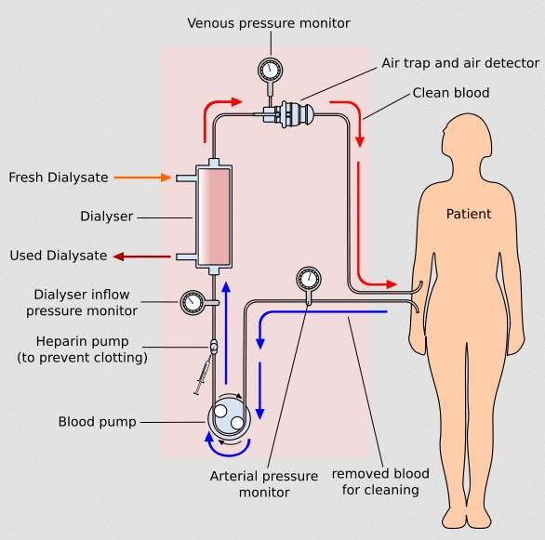
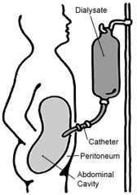
Dialysis
Type of Dialysis:
Hemodialysis (primary)
Peritoneal dialysis (primary)
Others
Hemofiltration
Hemodiafiltration
Intestinal dialysis
Back

Slide 17



Dr Jackson Kwizera NDEKEZI
Anesthesiologist
University of Rwanda

Slide 18


Definition
HUS, is a disease characterized by :
Hemolytic anemia
Uremia
Low platelet count
 It predominantly, but not exclusively, affects children.

Slide 19

Types HUS
Typical HUS
Atypical HUS
HUS due to Complement abnormalities

Slide 20

CLASSIFICATION OF HUS / TTP ACCORDING TO ETIOPATHOGENESIS
Type of HUS / TTP Specific Cause
 Infection related
Shiga toxin producing E.coli/Shigella
Pneumococcal infection
HIV
Other viral or bacterial infections
Typical
Complement factor abnormality
Factor H deficiency Factor I deficiency
CTD
Drugs
Malignancy
Miscellaneous
Atypical

Slide 21

ETIOPATHOGENESIS
Typical/Diarrhea associated/Shiga Toxin associated HUS
Enterohaemorrhagic E. coli
Shigella dysenteriae type 1
Rarely, HUS can occur with E. coli UTI

Slide 22

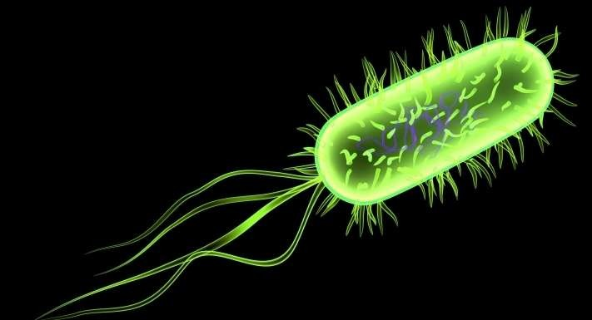

Slide 23

CONTI..
The common serotype of E coli:0157:H7
However, only about 10-15% patients with E. coli 0157:H7 infection will develop HUS
Sources of infection are :
Milk and animal products (incompletely cooked beef,
pork, poultry,lamb)
Human feco-oral transmission
Vegetables, salads and drinking water may be contaminated by bacteria shed in animal wastes

Slide 24

Atypical/Non-Diarrhea Related HUS
Pneumococcal HUS
HUS due to Complement abnormalities
Miscellaneous Causes of HUS / TTP
Abnormalities in intracellular vitamin B12 metabolism
HIV
Systemic lupus erythromatosus
Malignancies
Radiation
Certain drugs

Slide 25

Other infections associated with HUS
Include viruses like :
Influenza
Cytomegalovirus
Infectious mononucleosis
Bacteria like:
Streptococcii
Salmonella

Slide 26

CONTI…
 The typical pathophysiology involves the shiga-toxin binding to proteins on the surface of glomerular endothelium and inactivating a metalloproteinase called ADAMTS13, which is also involved in the closely related TTP

Slide 27

CONTI..
The arterioles and capillaries of the body become obstructed by the resulting complexes of activated platelets which have adhered to endothelium via large multimeric vWF.
The growing thrombi lodged in smaller vessels destroy RBCs as they squeeze through the narrowed blood vessels, forming schistocytes, or fragments of sheared RBCs.

Slide 28

CONTI…
The consumption of platelets as they adhere to the thrombi lodged in the small vessels typically leads to mild or moderate thrombocytopaenia
However, in comparison to TTP, the kidneys tend to be more severely affected in HUS, and the central nervous system is less commonly affected

Slide 29

CLINICAL FEATURES
The commonest clinical presentation of HUS is :
Acute pallor
Oliguria
Diarrhea or dysentery
It occurs commonly in children between 1-5 years of age
HUS develops about 5-10 days after onset of diarrhea

Slide 30

CONTI..
Hematuria and hypertension are common.
Complications of fluid overload may present with:
Pulmonary edema
Hypertensive encephalopathy
Despite thrombocytopenia, bleeding manifestations are rare
Neurological symptoms like:
Irritability
Encephalopathy
Seizures

Slide 31

INVESTIGATIONS
CBC
Peripheral blood smears
Reticulocyte count
LDH
Bili unconjigated
Cr & BUN
Urine analysis
Hemoglobinuria
Hematuria
Proteinuria

Slide 32

Investigations to Identify Cause
In patients with dirrhea, the identification of pathogenic EHEC or Shigella is performed by:
Stool culture
Further serotyping by agglutination or enzyme immunoassay
Rarely HUS can occur with E. coli UTI:
Urine cultures are indicated in non-diarrheal patients

Slide 33

Conti..
Bacteriological cultures of body fluids are indicated in suspected pneumococcal disease.
Sputum
CSF
Blood
Pus

Slide 34

Diagnosis
Clinically, HUS can be very hard to distinguish from TTP
The laboratory features are almost identical, and not every case of HUS is preceded by diarrhea
HUS is characterized by the triad of:
Hemolytic anemia
Thrombocytopenia
Acute renal failure

Slide 35

Cont…
The only distinguishing feature is that in TTP fever and neurological symptoms are often present, but this is not always the case
A pericardial friction rub can also sometimes be heard on auscultation
The two conditions are sometimes treated as a single entity called TTP/HUS.

Slide 36

MANAGEMENT
Supportive Therapy
Antibiotics
Plasma Therapy
Miscellaneous

Slide 37

Supportive Therapy
In all patients, supportive treatment is primary.
Close clinical monitoring of :
Fluid status
Blood pressure
Neurological
Ventilatory parameters
Blood levels of glucose, electrolytes, creatinine and hemogram need frequent monitoring

Slide 38

CONTI..
The use of antimotility therapy for diarrhea has been associated with a higher risk of developing HUS
With the onset of acute renal failure :
Fluid restriction
Diuretics

Slide 39

Antibiotics
E. coli
Shigellosis
pneumococcal HUS

Slide 40

Plasma Therapy
In aHUS due to :
complement factor abnormality
ADAMTS13 deficiency
 The replacement of the deficient factor with FFP
Daily plasma infusions (10 to 20 mL/kg/day)
Exchange of 1.5 times plasma volume ( 60 to 75 mL/kg/day) using FFP

Slide 41

Miscellaneous
In infants with HUS associated with cobalamin abnormalities:
Treatment with hydroxycobalamin
Oral betaine
Folic acid
Normalizes the metabolic abnormalities can help to prevent further episodes.

Slide 42

CONTI..
In patients with persistent ADAMTS13 antibodies and poor response to plasma exchange:
Immunosuppressive therapy with high dose steroids/cyclophosphamide/ cyclosporin/rituximab
Splenectomy

Slide 43

Prognosis
With aggressive treatment, more than 90% survive the acute phase.
About 9% may develop end stage renal disease.
About one-third of persons with HUS have abnormal kidney function many years later, and a few require long- term dialysis.
Another 8% of persons with HUS have other lifelong complications, such as :
High blood pressure
Seizures
Blindness
Paralysis

Slide 44

KEY MESSAGES
Good sanitation and maintenance of food hygiene can prevent diarrhea associated HUS.
Supportive care with early dialysis support remains the cornerstone of management.
Non-infective atypical HUS should be treated rapidly with plasma therapy.
Efforts should be made to make an etiological diagnosis in cases of atypical HUS as treatment and prognosis is affected.

Slide 45
NEPHROTIC SYNDROME
Dr KWIZERA NDEKEZI Jackson
Anesthesiologist
University of Rwanda

Slide 46
Definition
Nephrotic syndrome is a clinical complex characterized by a number of renal and extrarenal features, most prominent of which are
Proteinuria (in practice > 3.0 to 3.5gm/24hrs),
Hypoalbuminemia,
Edema,
Hypertension
Hyperlipidemia,
Lipiduria and
Hypercoagulabilty.

Slide 47
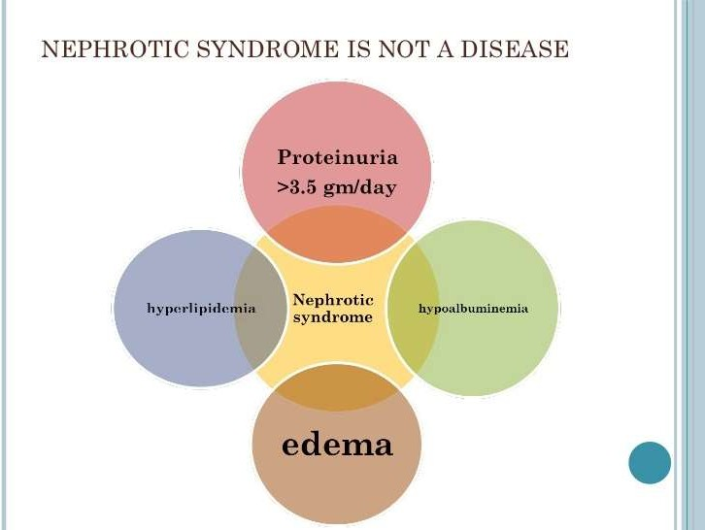

Slide 48
Classification
Nephrotic syndrome can be
Primary, being a disease specific to the kidneys,
Secondary, being a renal manifestation of a systemic
general illness

Slide 49
Primary causes
Primary causes include-
Minimal-change nephropathy(70-90% children and 10- 15%inadult)
Focal glomerulosclerosis (15%inadult)
Membranous nephropathy (30%inadult)
Mesangial proliferative glomerulonephritis .
Rapidly progressive glomerulonephritis

Slide 50
Secondary causes
Secondary causes include-
Diabetes mellitus
Lupus erythematosus
Amyloidosis and paraproteinemias
Viral infections (eg, hepatitis B, hepatitis C, HIV )
Preeclampsia

Slide 51
Nephrotic syndrome is 15 times more common in children
Most cases in children are due to minimal-change disease.
In adults, the most common form is membranous glomerulonephritis, followed by FSGS.
Diabetic nephropathy is emerging as a major cause of nephrotic syndrome

Slide 52
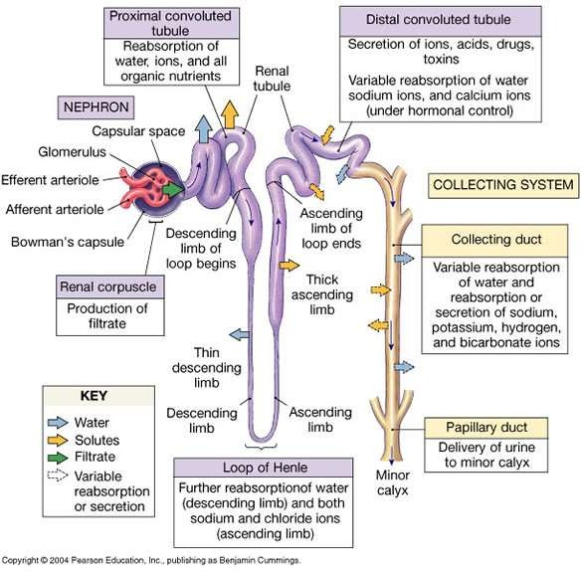
Nephron

Slide 53
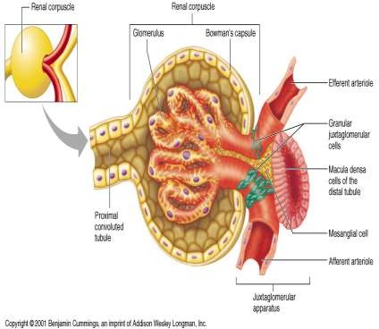
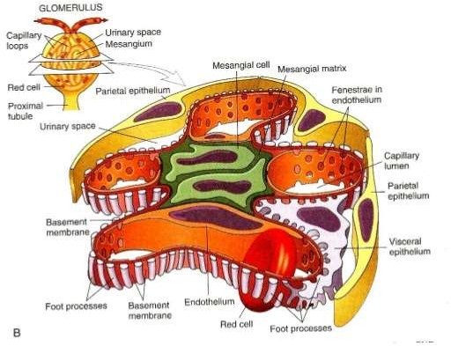
Normal glomerulus

Slide 54
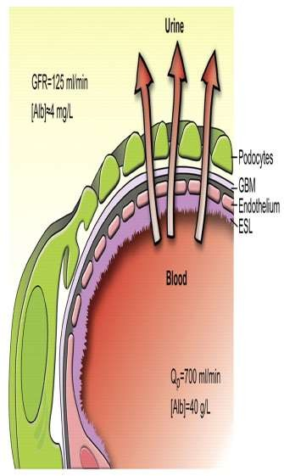
Pathophysiology of proteinuria
In a healthy individual, less than 0.1% of pl. albumin may traverse the glomerular filtration barrier.
glomerular capillaries are lined by a fenestrated endothelium that sits on the glomerular basement membrane
Which in turn is covered by glomerular epithelium, or podocytes, which envelops the capillaries with cellular extensions called foot processes. In between the foot processes are the filtration slits.
These 3 structures are the glomerular filtration barrier

Slide 55
Pathophysiology of proteinuria
The glomerular structural changes that may cause proteinuria are damage to the endothelial surface, the glomerular basement membrane, or the podocytes.
Glomerular haemodynamics (Intraglomerular hypertension and hyperfiltration) can alter Glomerular permeabiality.
Selectivity of proteinuria- Excretion of relatively low M.W. protein (Albumin or transferrin) is known as selective proteinuria while if excretion is predominately high M.W. protein (IgG, IgM or α2 macroglobulin) it is nonselective proteinuria.
It is also related to relative damage of Glomerular filter.

Slide 56
Hypoalbunemia
It is due to both the proteinuria and due to the increase renal catabolism (in tubules).
In fact hepatic albumin synthesis is increased from 145±9mg/kg/day to 213±17mg/kg/day in nephrotic patients.

Slide 57
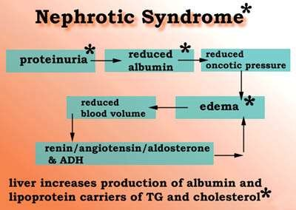
Pathogenesis of edema

Slide 58
Metabolic consequences of proteinuria
Metabolic consequences of the nephrotic syndrome include the following:
Infection
Hyperlipidemia and atherosclerosis
Hypocalcemia and bone abnormalities
Hypercoagulability
Hypovolemia

Slide 59
Proposed explanations of Infection in NS
Proposed explanations include the following:
Urinary immunoglobulin losses
Edema fluid acting as a culture medium
Protein deficiency
Decreased bactericidal activity of the leukocytes
Immunosuppressive therapy
Urinary loss of a complement factor (properdin factor B) that opsonizes certain bacteria

Slide 60
Hypperlipedemia
Due to increase hepatic lipoprotein synthesis that is triggered by reduced oncotic .
Defective lipid catabolism has also important role.
LDL and cholesterol are increased in majority of patients whereas VLDL and triglyceride tends to rise in patients with severe disease.
It increases the relative risk for MI 5.5 fold and coronary death
2.8 fold.
It also increases progression of renal disease

Slide 61
Hypercoagulability
Multifactorial in origin
Increase urinary loss of antithrombin III.
Altered levels and/or activity of protein C & S.
Hyperfibronogenemia due to increase hepatic synthesis.
Impaired fibrinolysis due to decrease plasminogen.
Increase platelet aggregability – relative immobility -
haemoconcentragtion from hypovolemia. – hyperlipidemia
Alteration in endothelial function

Slide 62
Hypocalcemia
Hypocalcemia is common in the nephrotic syndrome, but rather than being a true hypocalcemia, it is usually caused by a low serum albumin level.
Nonetheless, low bone density and abnormal bone histology are reported in association with nephrotic syndrome.
This could be caused by urinary losses of vitamin D– binding proteins, with consequent hypovitaminosis D and, as a result, reduced intestinal calcium absorption.

Slide 63
Hypovolemia
Hypovolemia occurs when hypoalbuminemia decreases the plasma oncotic pressure,
Resulting in a loss of plasma water into the interstitium and causing a decrease in circulating blood volume.
Hypovolemia is generally observed only when the patient's serum albumin level is less than 1.5 g/dL.
Hypotension is a late feature

Slide 64
FUNCTIONAL CONSEQUENCE OF URINARY LOSS OF PLASMA PROTEIN
Thyroid binding globulins and thyroxin – may lead to hypothyroidism.
Vit D binding protein – oesteomalacia, but rare
Total calcium is also low due to low albumin level.
Transferrin and erythropoietin and – microcytic hypochromic anemia.
ARF – is rare in nephrotic syndrome. In whom it occur patient are elderly of minimal changes disease / FGSS

Slide 65
Symptoms and signs
Include anorexia, malaise, puffy eyelids, retinal sheen, abdominal
pain, wasting of muscles, and edema.
The edema is mobile
Focal edema may be the reason for seeking help
complaints as:
difficulty breathing (pleural effusion or laryngeal edema),
substernal chest pain (pericardial effusion),
scrotal swelling,
swollen knees (hydroarthrosis),
swollen abdomen (ascites), and
for such
abdominal pain from edema of the mesentery.

Slide 66
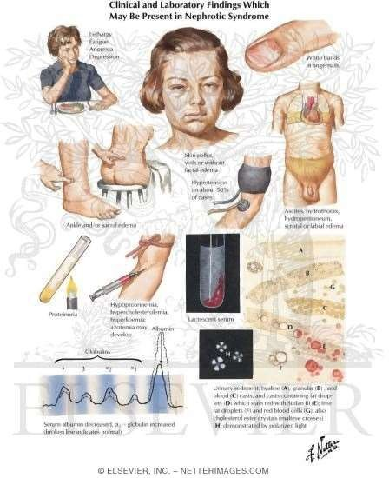
Symptoms and signs
An early sign of NS is frothy urine.
At presentation,proteinuria is usually > 2 gm/m2/day, or a urine protein/creatinine ratio is > 2
Orthostatic hypotension and even shock
may develop in children.
Adults may be hypo-, normo-, or hypertensive.
Oliguria and even
Acute renal failure may develop because of hypovolemia and diminished perfusion.

Slide 67
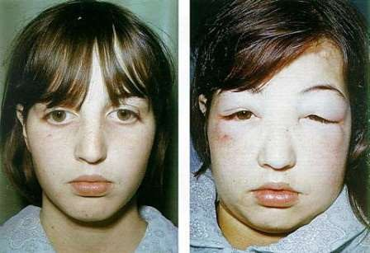
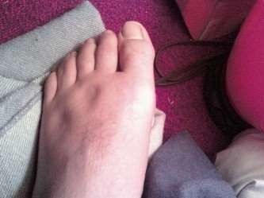
Symptoms and signs
Prolonged NS may result in nutritional deficiencies, including protein malnutrition
,myopathy,
Decreased total Ca++, tetany
Spontaneous peritonitis and opportunistic
infections
Coagulation disorders, with decreased fibrinolytic activity
Episodic hypovolemia, are a serious thrombotic risk ( renal vein thrombosis).
Hypertension with cardiac and cerebral complications.

Slide 68
Differential Diagnosis
Heart failure
Cirrhosis
Glomerulonephritis

Slide 69
Workup
Diagnostic studies for nephrotic syndrome may include the following:
Urinalysis
Urine sediment examination
Urinary protein measurement (24-hr)
Serum albumin
Serologic studies for infection and immune abnormalities
Renal ultrasonography
Renal biopsy

Slide 70
IMPORTANT DEFINITIONS
RESPONSE; protein free urine on 3 consecutive days within 7 days.
RELAPSE; protein +ve urine on 3 consecutive days within one week
with edema.
FREQUENT RELAPSING NS; steroid sensitive nephrotic syndrome with 2 or more relapses in 6 months or more than 3 in one year.
STEROID DEPENDANT; responder who relapses while steroid is being tapered or within 14 days of stopping steroid treatment.
INITIAL NON RESONDER; no response during initial 8 weeks of
therapy.
LATE NON RESPONDER; an initial steroid responder who fails to respond to 4 week treatment in relapse.

Slide 71
Management
Specific treatment
In minimal-change nephropathy, glucocorticosteroids, such as prednisone,
are used. Children who relapse may be treated with rituximab]
In some lupus nephritis, prednisone and cyclophosphamide are useful
Secondary amyloidosis with nephrotic syndrome may respond to
inflammatory treatment of the primary disease.
anti-
In membranous nephropathy, expectant management without immunosuppression can be used for the first 6 months, in patients at low risk for progression (ie, those with serum creatinine level < 1.5 mg/dL). Patients with renal insufficiency (serum creatinine level > 1.5 mg/dL) are at greatest risk for the development of end-stage renal disease and should receive immunosuppressive therapy.^{[37]}

Slide 72
Management
Diet and activity
The diet in patients with nephrotic syndrome should provide adequate energy (caloric) intake and adequate protein (1-2 g/kg/d).
A diet with no added salt will help to limit fluid overload.
Management of hyperlipidemia could be of some importance if the nephrotic state is prolonged.
Fluid restriction per se is not required.
Ongoing activity, rather than bed rest, will reduce the risk of blood clots.

Slide 73
Management
Acute Nephrotic Syndrome in Adults
Diuretics will be needed; furosemide, spironolactone, and even metolazone may be used. Volume depletion may occur with diuretic use, which should be monitored.
Anticoagulation has been advocated by some for use in preventing
thromboembolic complications,
Hypolipidemic agents may be used, but if the nephrotic syndrome cannot be controlled, the patient will have persistent hyperlipidemia.
ACE inhibitors and/or ARB are widely used. These may reduce proteinuria by reducing the systemic blood pressure, by reducing intraglomerular pressure, and also by direct action on podocytes.

Slide 74
Management
Long-Term Monitoring- Follow-up care in patients with nephrotic syndrome includes
Immunization,
Treatment of relapses of steroid-responsive nephrotic
syndromes,
Monitoring for steroid toxicity, and
Monitoring of diuretic and angiotensin antagonist regimens.

Slide 75
Medication Summary
Corticosteroids (prednisone),
Cyclophosphamide,
Cyclosporine
Rituximab
Mycophenolate
Diuretics
ACE inhibitors and
ARB

Slide 76
Tumor of kidney and urinary tract

Slide 77
The most common is renal cell carcinoma,
Followed by nephroblastoma (Wilms tumor) ,
Then 1ry tumor of calyces and pelvis.
Tumors of the lower urinary tract are more common than renal cancer.

Slide 78
I- renal cell carcinoma
It originates from renal tubular epithelium and hence is located in the cortex.
Renal carcinoma represents 80-85%of primary malignant tumors of the kidney.
It affects male more common in six to seventh decades.

Slide 79
I- renal cell carcinoma
Risk factors include
Smoking,
Exposure to cadmium, and
Cysts acquires in haemodialysis patients.

Slide 80
I- renal cell carcinoma
Three common forms are found:
Clear cell carcinoma
Papillary renal cell carcinoma
Chromophobe renal carcinoma

Slide 81
A- Clear cell carcinoma
most common type.
Accounting for 70-80% of renal cancers.
The majority of this type is sporadic but few cases occur in familial form on association with VonHippel-Lindaue (VHL) disease.

Slide 82
A- Clear cell carcinoma
VHL is an autosomal dominant disease characterized by predisposition to a variety of neoplasm.
These patients show mutation and loss of VHL gene located on chromosome 3.
The loss of VHL gene (Tumor suppressor gene) give rise to clear cell carcinoma.

Slide 83
B- Papillary Renal Cell Carcinoma
It account for 10-15% of renal cancer.
Like clear cell carcinoma, this tumor occurs in sporadic and familial forms,
But unlike clear cell carcinoma papillary renal cancer has no abnormalities of chromosome 3.

Slide 84
B- Papillary Renal Cell Carcinoma
There is over expression of MET gene (proto-oncogene) located on chromosome 7.
This gene is responsible for cell growth.
Trisomy of chromosome 7 is seen commonly in this cancer.

Slide 85
C-Chromophobe renal carcinoma
It is rare tumor It account for 5% only of renal cancer.
There is multiple chromosomal abnormalities including 1,2,6,10,13,..

Slide 86
Morphology of renal carcinoma
Macroscopic picture:
1- Clear cell carcinoma:
Are usually solitary,
May be large in size.
It arise in cortex.
The cut surface is yellow to orange due to high lipid content.

Slide 87
Morphology of renal carcinoma
Macroscopic picture:
1- Clear cell carcinoma:…
It shows areas of cystic softening and hemorrhage.
As the tumor enlarge it invade the wall of collecting system
(calyces ,renal pelvis), renal vein, inferior vena cava ,adrenal gland and other tissues.

Slide 88
..…Morphology of renal cancer
2- Papillary renal carcinoma:
Tend to be bilateral and multiple .
It has less lipid content.
There is evidences of necrosis , hemorrhage, and cystic degeneration.
3- Chromophobe type:
Rare & has a brownish color

Slide 89
… Morphology
Microscopic examination:
1- Clear cell carcinoma: depending on the amount of lipid content ,the cells of clear cell carcinoma may appear
Vacuolated (lipid laden) or
Granular resemble tubular epithelium.

Slide 90
… Morphology
Microscopic examination:
2- papillary renal carcinoma: it exhibits varying degree of papillary formation with fibro vascular core.
3-Chromophobe renal cancer: The tumor cells stain more darkly (less clear) than cell in clear cell carcinoma

Slide 91
Clinical features of renal cell carcinoma
The most frequent symptom is painless hematuria in over 50% of cases.
Less commonly the tumor may enlarge and become palpable.

Slide 92
Clinical features of renal cell carcinoma
Extra renal effect:
Fever ,
Polycythemia (release of erythropoietin) .
Secretion of other hormone substances leading to hypocalcaemia, hypertension, Cushing syndrome,...
In most cases it remains silent and discovered after metastasis develop.

Slide 93
)II- Wilms tumor (nephroblastoma
It is one of the most common cancer in children.
It contains a variety of cells and tissue components derived from the mesoderm.
Most cases occur between 2-5 years.

Slide 94
(II- Wilms tumor (nephroblastoma
Wilms tumor is associated with some congenital malformations disorders,
One of these disorders is WAGR syndrome characterized by genital abnormalities and mental retardation.
These disorders are associated with loss of tumor suppressor gene on chromosome 11.

Slide 95
Morphology of Wilms tumor
Macroscopic:
The tumor tends to present mostly as a large ,solitary ,well circumscribed mass.
On cut surface ,the tumor is gray, homogenous with foci of hemorrhage, cystic changes and necrosis.

Slide 96
Morphology of Wilms
■
■
Microscopically:
The tumor is characterized by a classical triphasic combination of
Blastemal ,
Stromal and
Epithelial cell types .

Slide 97
Morphology of Wilms
Microscopically:
The blastemal component, characterized by
sheets of blue small cells
Epithelial cells usually takes the form of abortive tubules.
Stromal cells are usually fibrocystic in nature although skeletal muscle differentiation is not uncommon.
Approximately 5% of tumor are anaplastic. (Large cell with abnormal mitosis)

Slide 98
Clinical picture of Wilms
The clinical picture usually refer to the large size of the tumor,
There is palpable abdominal mass.
The patient presents with
Fever,
Abdominal pain and
Hematuria.

Slide 99
Clinical picture of Wilms
The prognosis is good and
Excellent results are obtained after combination of nephrectomy and chemotherapy.

Slide 100
II
Tumor Of Urinary Bladder

Slide 101
II- tumor of urinary bladder
■
■
It is common in men between 50-70 year . Risk factors include
Cigarette smoking ,
Schistosomiasis,
Chronic cystitis,
Certain drugs (As cyclophosphamide( and
Chemical exposure to B- naphthylamine.

Slide 102
Morphology of bladder cancer
Benign tumor is rare (papilloma).
Malignant tumor is classified into three forms;
1- Urothelial (transitional )cell carcinoma;
2- Squamous cell carcinoma:
3- Carcinoma in situ;

Slide 103
Morphology of bladder cancer
1- Urothelial (transitional) cell carcinoma; The commonest type.
It ranges from
Papillary to flat,
Non-invasive to invasive and
Well differentiated to undifferentiated or anaplastic cancer.

Slide 104
Morphology of bladder cancer
1- Urothelial (transitional) cell carcinoma; The commonest type.
Grade I is usually non invasive.
Evidence of invasion of submucosa and muscle layers are seen in grade II and III.

Slide 105
Morphology of bladder cancer
2- squamous cell carcinoma: occur only in 5%
3- carcinoma in situ;
early stage of dysplasia or atypical hyperplasia are found.

Slide 106
Clinical picture of bladder cancer
Painless hematuria is the commonest presentation.
The clinical course depends on
The histological grade and
Degree of differentiation and
Depth of invasion.
Lesion invading the ureters lead to hydronephrosis.

Slide 107
III
Neoplasm Of Collecting System
Renal Calyces,
Renal Pelvis &
Ureters.

Slide 108
III- neoplasm of collecting system
■
Collecting system neoplasm is rare (5-10% of primary renal tumors)
It include renal calyces, renal pelvis and ureters.
Painless hematuria is the presenting symptom
Hydronephrosis could occur.

